Slide 1
Salaries for San Francisco Employees
Domain: Finance Analyst
Tools Used: Python, Pandas, Matplotlib, Seaborn, Scikit-learn
Name: K.Sathvika

Slide 2
Introduction
This project focuses on analyzing salary data of San Francisco city employees. The dataset contains detailed information about employee compensation, including base pay, overtime pay, other pay, and benefits. The analysis aims to understand salary patterns, trends, and variations across different job roles and years, using data analytics and visualization techniques.

Slide 3
Objective
The main objective of this project is to analyze the salary structure of San Francisco city employees by examining different salary components such as BasePay, OvertimePay, OtherPay, and Benefits. The project also aims to identify salary trends across job roles and years and to build a machine learning model to predict employee salaries.
Analyze salary distribution and patterns
Compare compensation across job roles
Study salary trends over different years
Predict employee salaries using machine learning

Slide 4
Tools Used
Python: Used as the main programming language for analysis
Pandas: Used for data loading, cleaning, and manipulation
NumPy: Used for numerical computations
Matplotlib: Used for basic data visualizations
Seaborn: Used for advanced statistical visualizations
Scikit-learn: Used for building and evaluating machine learning models

Slide 5
Dataset Overview
The dataset contains salary details of San Francisco city employees.
It includes information related to employee job titles, departments, and salary components.
Key salary components in the dataset are BasePay, OvertimePay, OtherPay, and Benefits.
The dataset covers multiple years, allowing trend analysis over time.

Slide 6
Key columns
Id: Unique identifier for each employee record
EmployeeName: Name of the employee
JobTitle: Job role/designation of the employee
BasePay: Base salary paid to the employee
OvertimePay: Additional pay for overtime work
OtherPay: Other types of compensation
Benefits: Benefits received by the employee
TotalPay: Sum of base pay, overtime pay, and other pay
TotalPayBenefits: Total compensation including benefits
Year: Year of the salary record

Slide 7
Data Preprocessing / Data Cleaning
Handled missing and null values in salary-related columns.
Converted salary columns to numeric format for analysis.
Removed or corrected invalid and inconsistent data entries.
Ensured the dataset was clean and ready for analysis and modeling.

Slide 8
Data Profiling
Data profiling was performed to understand the structure and quality of the dataset.
It helped identify missing values, data types, and value distributions.
Summary statistics provided an overview of salary components.
Outliers and extreme values in salary fields were identified.
This step helped validate data readiness before EDA and modeling.

Slide 9
Exploratory Data Analysis
Performed exploratory analysis to understand salary distribution and patterns.
Analyzed salary components such as BasePay, OvertimePay, and Benefits.
Visualized salary trends across different job roles and years.
Identified key patterns, variations, and relationships in the data.

Slide 10
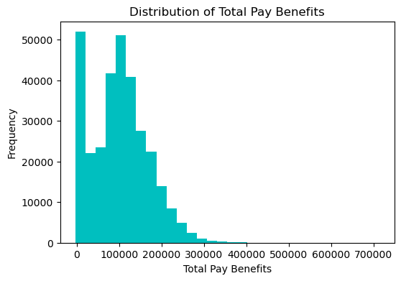
1. Distribution of Total Pay Benefits

Slide 11
Key Insights:
Most employees fall in the low to mid salary range
Very few employees earn extremely high total pay
Salary distribution is highly right-skewed
High compensation is concentrated among limited roles

Slide 12
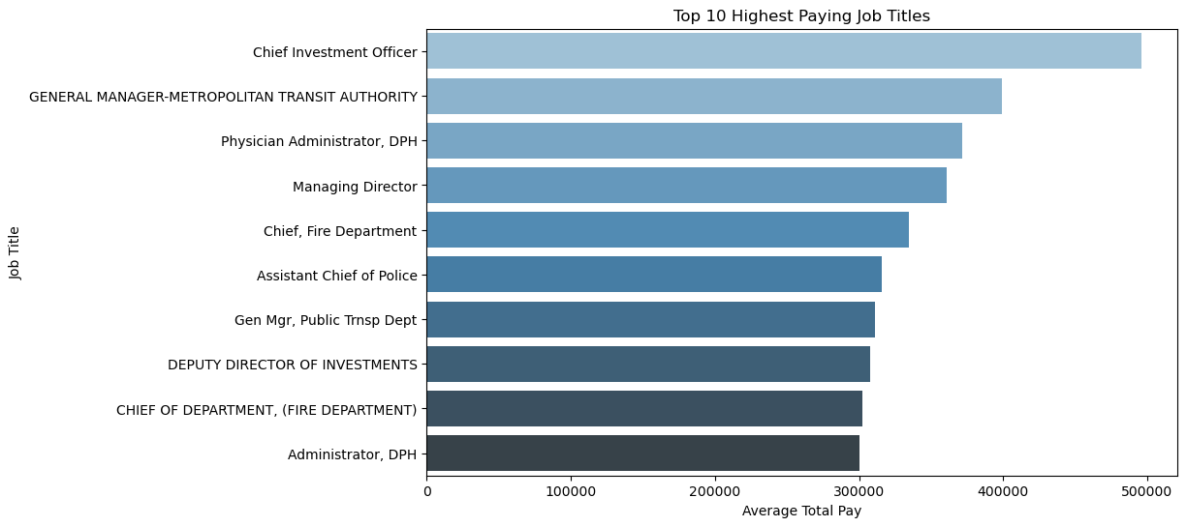
2. Top 10 Highest Paying Job Titles

Slide 13
Key Insights:
Executive and senior leadership roles dominate top salaries
Chief investment Officer has the highest average pay
Healthcare and public safety leadership roles are highly paid
Higher responsibility roles receive significantly higher compensation

Slide 14
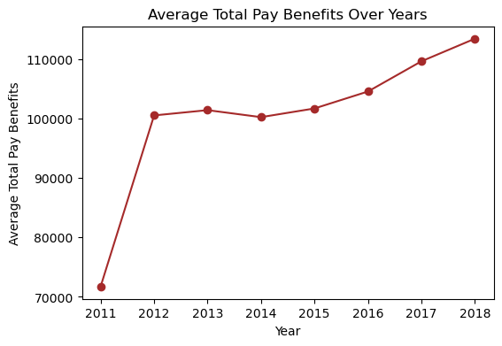
3. Salary Trend Over the Years

Slide 15
Key Insights:
Average salary increased significantly after 2011
Minor fluctuations observed during mid-years
Steady growth in salaries from 2016 onwards
Overall upward trend in employee compensation

Slide 16
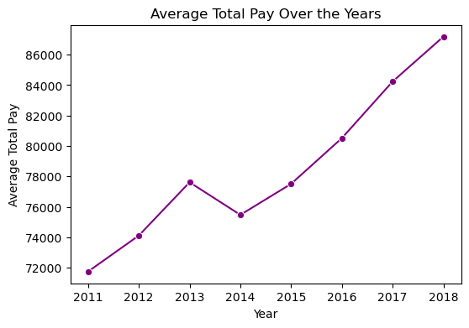
4. Average Total Pay Over the Years

Slide 17
Key Insights:
Average total pay increased steadily over the years
Small decline observed around 2014
Strong salary growth after 2015
Overall positive upward salary trend

Slide 18
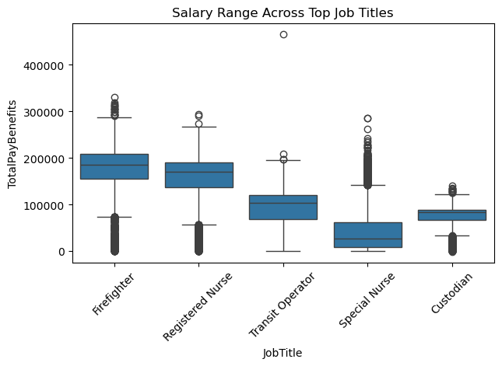
5. Salary Range by Job Title

Slide 19
Key Insights:
Firefighters and Registered Nurses have higher median salaries
Special Nurses show many highh-value outliers
Transit Operators and Custodians earn Comparatively lower pay
Salary variation differs significantly across job roles
Presence of outliers indicates pay inequality within some roles

Slide 20
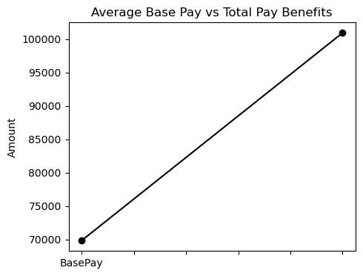
6. Base Pay vs Total Compensation
Key Insights:
Total Pay Benefits are much higher than Base Pay
Benefits & additional pay components play a major role
Base salary alone does not reflect actual employess earnings
Compensation structure includes multiple earnning components

Slide 21
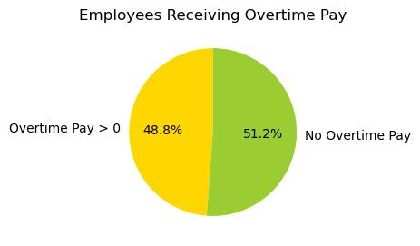
7. Employees Receiving Overtime Pay
Key Insights:
Nearly half of employees receive overtime pay
Slightly more employees do not receive overtime compensation
Overtime pay is role-dependent
Indicates variation in workload & workig hours

Slide 22
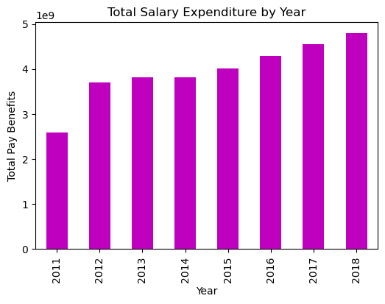
8. Total Salary Expenditure by Year

Slide 23
Key Insights:
Total salary expenditure increases year by year
Lowest expenditure observed in the intial year
Continuous growth after 2014
Indicate rising workforce cost and compensation growth
Reflects organizational expansion and pay revisions

Slide 24
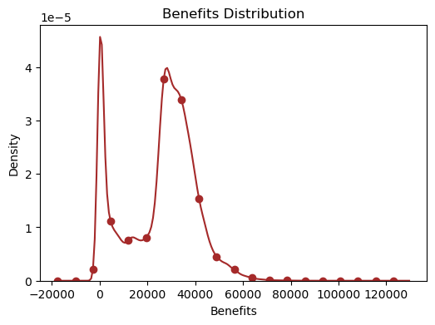
9. Benefits Distribution

Slide 25
Key Insights:
Most employees receive low to moderate benefits
Benefits distribution is right-skewed
Few employees receive very high benefits
Presence of outliers at higher benefit values
Indicates variation in benefits across job roles

Slide 26
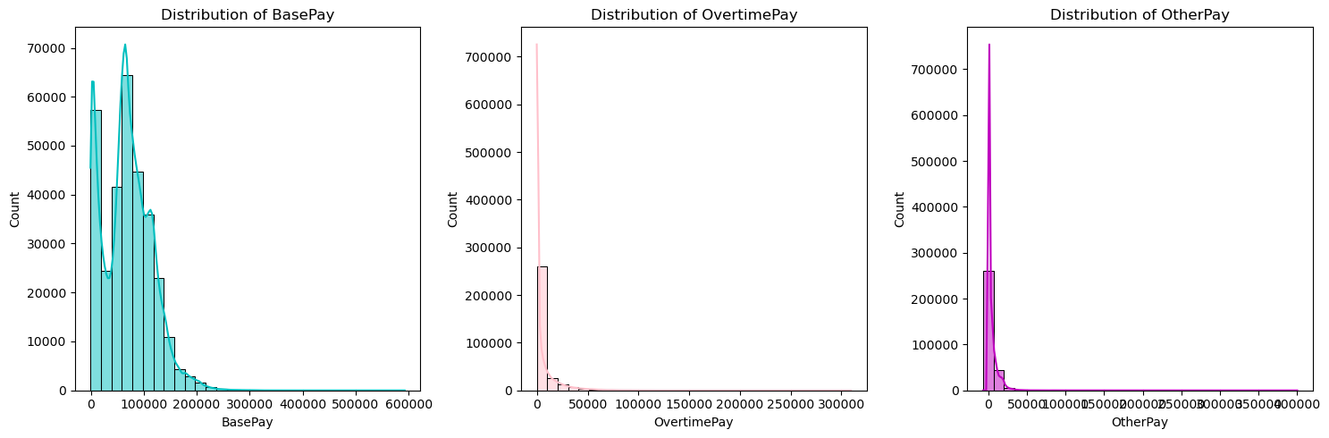
10. Distribution of BasePay, OvertimePay, and
OtherPay

Slide 27
Key Insights:
Distribution of BasePay:
Majority of employees earn low to mid-level salaries
Few employees receive very high base pay
Distribution is right-skewed
Distribution of OvertimePay:
Most employees receive little or no overtime pay
Very few employees earn high overtime
OvertimePay is highly uneven

Slide 28
Key Insights:
Distribution of OtherPay
OtherPay values are mostly low
Only a small number receive high additional pay
Contribution is less compared to Basepay

Slide 29
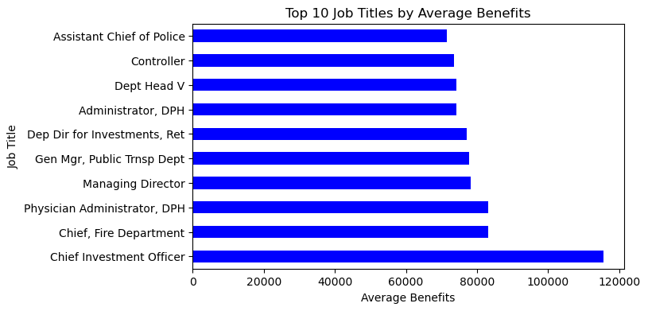
11. Top 10 Job Titles by Benefits

Slide 30
Key Insights:
Senior and leadershipp roles receive the highest benefits.
Administrative and public safety roles dominate top benefit positions.
Benefits increase with responsibility and position level.

Slide 31
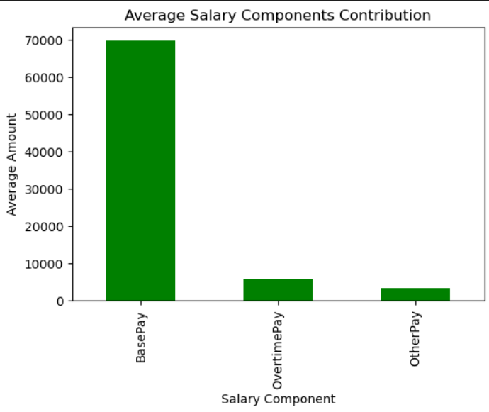
12. Average Salary Components Contribution

Slide 32
Key Insights:
BasePay is the major contributor to total salary.
OvertimePay contributes moderately.
OtherPay has minimal impact on overall salary.

Slide 33
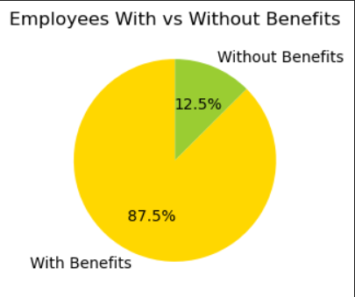
13. Percentage of Employees With vs Without
Benefits

Slide 34
Key Insights:
Most employees receive benefits.
Very few employees fall under “Without Benefits”.
Benefits are a standard part of compensation structure.

Slide 35
Model Building
Selected relevant salary-related features for analysis prediction.
Split the dataset into training and testing sets.
Applied a regression-based approach to model salary relationships.
Trained the model using the training dataset.
Prepared the model for performance evaluation.

Slide 36
Model Evaluation
Evaluated the performance of the regression model using standard evaluation metrics.
measured prediction accuracy by comparing actual salaries with predicted salaries.
Used metrics such as Mean Absolute Error (MAE), Mean Squeared Error (MSE), and R² score.
This step helps in understanding how well the model fits the data and its reliability.

Slide 37
Final Insights:
BasePay is the most influential component of total salary.
Job title plays a significant role in salary variation.
Benefits are provided to the majority of employees.
OvertimePay and OtherPay vary across different roles and departments.
The analysis reveals clear salary patterns within the dataset.

Slide 38
Conclusion
This project analyzed San Francisco employee salary data using exploratory data analysis and basic modeling techniques.
Key salary components and compensation trends were identified.
The insights gained can help in understanding salary structures and workforce compensation patterns.

Slide 39
Thank You

